Slide 1

Computer Architecture and Operating Systems CS 3230 :Assembly Section Lecture 8
Department of Computer Science and Software Engineering
University of Wisconsin-Platteville

Slide 2
Introduction
An array is a contiguous block of list of data in memory
All elements must be the same size (number of bytes of memory)
The address of any element can be computed by:
The address of the first element of the array
The number of bytes in each element
The index of the element
Notes:
In c++: in assembly:
Const int size = 5; size equ 5 ; in .data
Int A[size] = {1, 2, 3, 4, 5}; A db 1, 2, 3, 4, 5 ; in .data
Int B[size]; B resd size ;in .bss
Adresses: array name + (index * number of bytes)
Ex. B[2] = B + 2
To access:
Mov ebx, array name
Mov esi, index
So element = [ebx + esi]

Slide 3
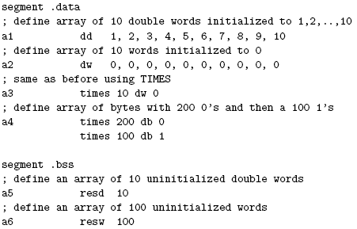
Defining arrays

Slide 4
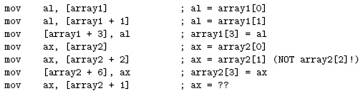
Accessing elements of arrays
To access an element of an array, its address must be computed
Example:
array1 db 5, 4, 3, 2, 1 ; array of bytes
array2 dw 5, 4, 3, 2, 1 ; array of words

Slide 5
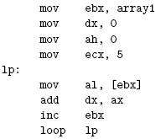
Adds all the elements of array1

Slide 6

Multidimensional arrays
They are represented in memory as just that, a plain one dimensional array
Two Dimensional Arrays, e.g. int a[3][2]
This is known as the rowwise representation of the array and is how a C/C++ compiler would represent the array

Slide 7
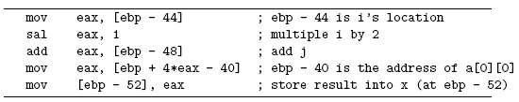
An example: how gcc compiles x = a[i][j]
The compiler essentially converts the code to: x = (&a[0][0] + (number of columns*i*s) + j )
s is the element size

Slide 8
LEA instruction
LEA: Load Effective Address
Syntax : LEA dest, address
calculate the address and store it into dest
Usually used for indirect memory addressing
Address is given in the following format
[base reg + factor *index reg + constant ]
Example:
lea ebx, [4*eax + ecx]
stores the value of (4 × EAX+ECX) into EBX

